Slide 1
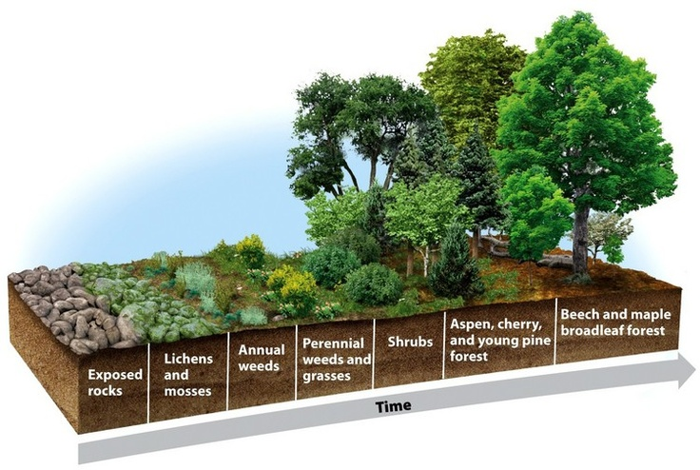
Ecological succession

Slide 2
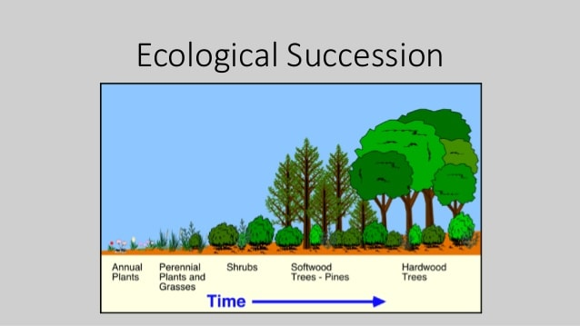
Succession : Natural, gradual changes in the types of species that live in an area or
Gradual replacement of one community by another in the development of vegetation towards a climax, which is the culmination stage in plant succession for a given environment
The plant communities involved in the succession before the climax is reached are called seres. Sere is defined as the series of plant communities resulting from processes of succession or any recognizable stage in plant succession.
Concept of succession
The basic feature of concept of succession are
There is a continual change in the vegetation as a result of interaction of plant community and the habitat factors;
The succession is inherently and inevitably progressive and the end product is the climax ; and
The succession is the progressive development of vegetation on the same site in course of time.

Slide 3
Kinds of succession
succession can be classified mainly in two ways
On basis of moisture conditions of the place
On basis of presence or absence of vegetation in the place
On basis of moisture
Xerarch succession which is defined as the succession initiated in extremely dry situation such as bare rock, wind blown sand, rocky talus slope etc
The successional stages are called Xerosere which is defined as the different stages in a xerarch succession
Xerosere may further be subdivided into lithosere which originate on rock surface and Psammosere which originate on sand.
Hydrarch succession which is defined as the succession beginning in water, or very wet land as in ponds, lakes, marshes etc. The various stages are called hydrosere

Slide 4
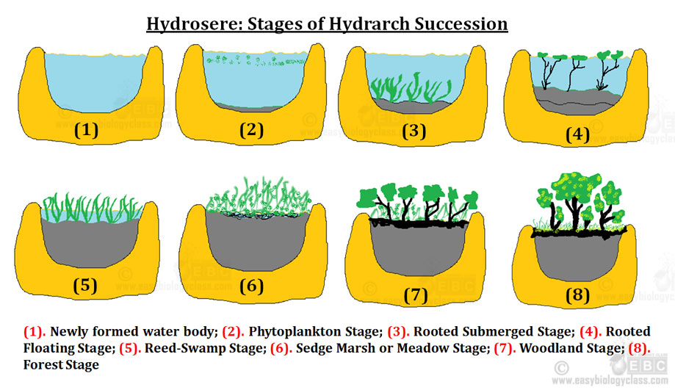
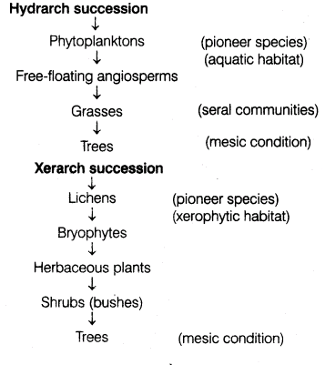
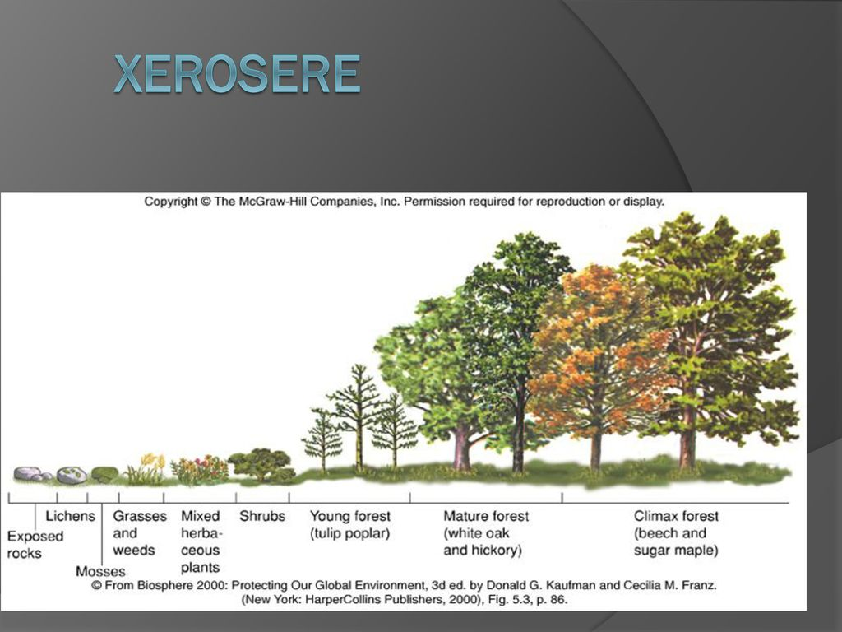

Slide 5
On basis of presence or absence of vegetation
Primary succession which is defined as the succession which take place on sites which have previously not borne by any vegetation. Also called as autogenic succession which are defined as the dominating factors of change which are due only to the individual in a plant community.
Secondary succession which is defined as succession which take place on sites after the destruction of the whole or part of the original vegetation also called as allogenic succession which is defined as factors which operate, independently on the plant themselves, to alter the habitat gradually and thus cause change in vegetation e.g clearing, burning, grazing etc

Slide 6
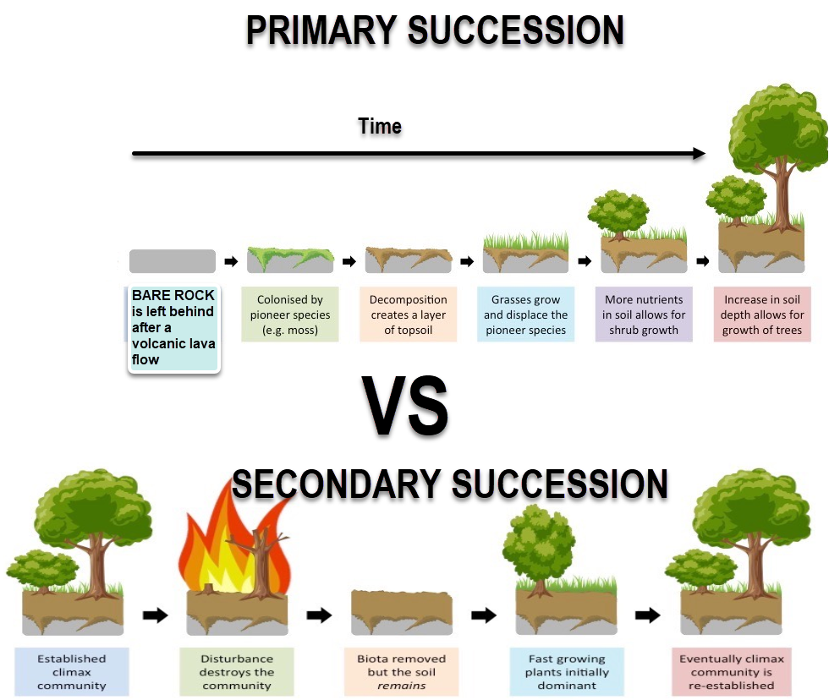

Slide 7
Causes of succession
Following are the causes of ecological succession:
1. Initial Causes:
Causes those are responsible for the destruction of existing habitat. Such occurrences happen due to the following factors:
(a) Climatic Factor:
Such as wind, deposits, erosion, fire etc.
(b) Biotic Factor:
Such as various activity of organisms.
2. Continuing Causes:
Causes those are responsible for changes in population shifting features of an area. Such factors are:
(a) Migration for safety against outside aggregation.
(b) Migration due to industrialization and urbanization.
(c) As a reactionary step against local problems.
(d) Feeling of competition
3. Stabilizing Cause:
Causes which bring stability to the communities. Such factors are:
(a) Fertility of land
(b) Climatic condition of the area
(c) Abundance of availability of minerals etc.

Slide 8
Process of succession
The entire process of primary autotrophic succession is completed through a series of sequential steps followed by one after another.
The different sequential steps may be outlined as below:
(1) Nudation:
It is a process of developing a bare area without any form of life for the arrival of new species. The causes of nudation may be:
(a) Topographic:
The existing community may disappear due to soil erosion (by gravity, water or wind), land slide, volcanic activity etc.
(b) Climatic:
The existing community may be destroyed due to storm, fire, frost, drought.
(c) Biotic:
The community may also be destroyed by anthropogenic activities like destruction of forest, destruction of grass land etc. Besides, diseases induced by bacteria and virus can also destroy the population.

Slide 9
(2) Invasion:
The successful establishment of a species in a bare area is called as invasion. This process of establishment is completed in three successive steps:
(a) Migration (dispersal):
The seeds, spores or other progagules of the species are brought to the bare area by the agents like air, water etc.
(b) Ecesis (Establishment):
The process of successful establishment (germination and growth) of the species in the new area as a result of adjustment with the prevailing conditions is known as ecesis.
(c) Aggregation:
After ecesis, the individuals of species increase their number by reproduction and thus, are aggregated in a particular area.
(3) Competition and Coaction:
As the species aggregate at a limited space, there happens competition (inter as well as intra specific) mainly for space and nutrition. Secondly the life process of one individual is affected by the surrounding species in various ways which is known as coaction. The species which are found unable to compete with others in the existing environment get discarded.

Slide 10
(4) Reaction:
The species present in an environment constantly interact with it there by causing its modification. The mechanism of the modification of the environment through the influence of living organisms on it, is known as reaction.
Reaction induces changes in soil composition, water content, light condition, temperature etc. Due to drastic modifications of the environment/ it may not be suitable for the existing community.
Hence, the existing community may be replaced by another community. The whole sequence of communities that substitute one another in the given area is known as sere and the various communities constituting the sere are known as seral communities or seral stages.
(5) Stabilization (Climax):
At last a final or terminal community is established. Which is stabilized for a longer period of time and which can maintain an equilibrium with the environment of that area. This community is known as climax community and the stage is as climax stage.

Slide 11
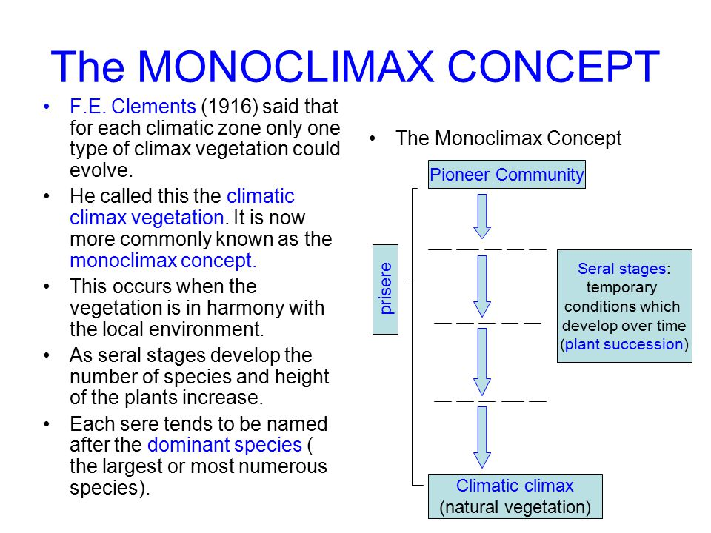
Theories of climax
The final stage of succession is called the climax or climax community (Clements, 1936; Shimwell 1971).
It is the final or stable community in a successional series. It is self-perpetuating and in equilibrium with the physical and biotic environment.
Climax communities undergo changes in structure as a result of birth, death and growth processes in the community.
There are following theories of the climax:
1. Mono-climax Theory:
According to the mono-climax theory of succession (Clements, 1936), every region has one climax community toward which all communities are developing. He believed that climate was the determining factor for vegetation and the climax of any area was solely a function of its climate. Various terms such as sub-climax, dis-climax, post-climax, and pre-climax are used to describe the deviations from the climatically stabilized climax. These communities, controlled by topographic, edaphic (soil), or biotic factors are regarded as exceptions by the supporters of the mono-climax view.

Slide 12
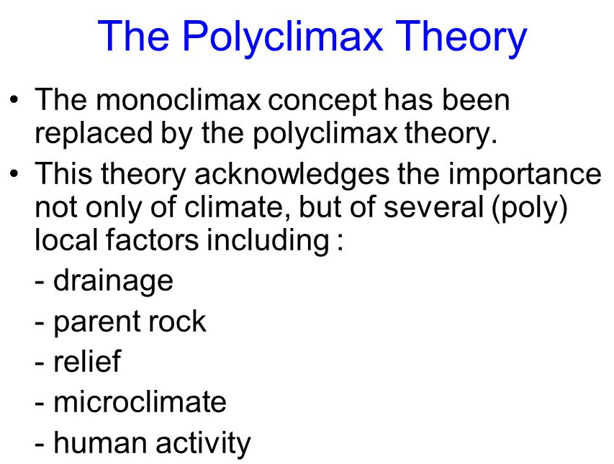
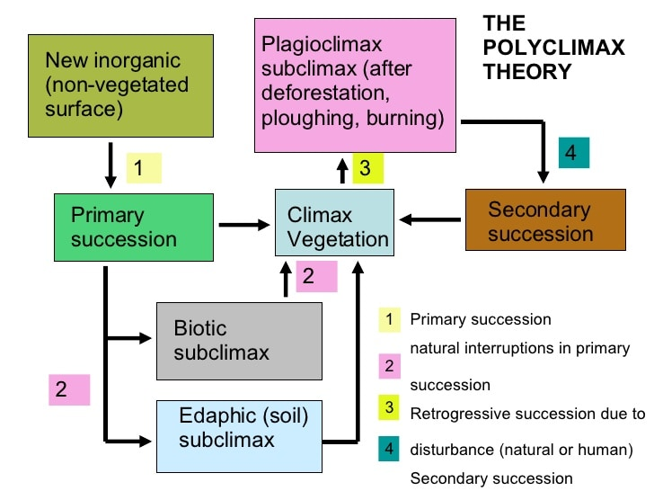
2. Poly climax Theory:
This theory was proposed by Tansley (1939) and later supported by Daubenmire (1966). The poly-climax theory of succession holds that many different types of vegetation as climax communities may be recognized in a given area. These will be climaxes, controlled by soil moisture, soil nutrients, activity of animals and other factors. According to this theory, climate is only one of the several factors, any of which may have a controlling influence on the structure and stability of the climax. This allows many climaxes in a climate region and is, therefore, called the poly-climax theory.
3. Climax-pattern Theory:
Whittaker (1953) emphasized that a natural community is adapted to the whole pattern of environmental factors in which it exists; the major factors are: genetic structure of each species, climate, site, soil, biotic factors (activity of animals), fire, and wind, availability of plant and animal species, and chances of dispersal. According to this theory, climax communities are patterns of populations varying according to the total environment. There is thus no discrete number of climax communities and no one factor determines the structure and stability of a climax community.

Slide 13
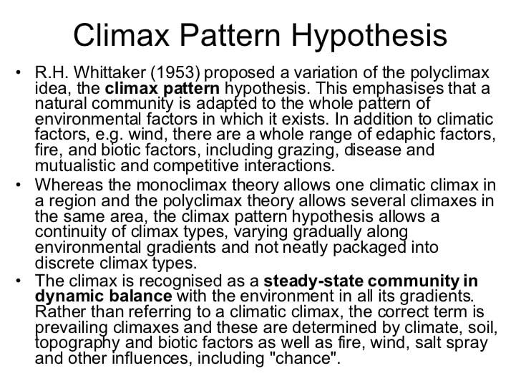
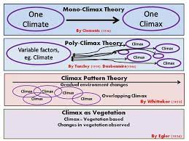

Slide 14
Biome
Biomes are the biotic community of geographical extent characterized by distinctiveness in the life forms of the important climax species. They are very large ecological areas on the earth’s surface, with fauna and flora (animals and plants) adapting to their environment. Biomes are often defined by abiotic factors such as climate, relief, geology, soils and vegetation.
There are five major categories of biomes on earth. In these five, there are many sub-biomes, under which are many more well defined ecosystems.
The Desert Biomes: They are the Hot and Dry Deserts, Semi Arid Deserts, Coastal Deserts and Cold Deserts. The Aquatic Biomes: Aquatic biomes are grouped into two, Freshwater Biomes (lakes and ponds, rivers and streams, wetlands) and Marine Biomes (oceans, coral reefs and estuaries). The Forest Biomes: There are three main biomes that make up Forest Biomes. These are the Tropical Rainforest, Temperate and Boreal Forests (also called the Taiga) The Grassland Biomes: There are two main types of grassland biomes: the Savanna Grasslands and the Temperate Grasslands. The Tundra Biomes: There are two major tundra biomes—The Arctic Tundra and the Alpine Tundra. Biomes play a crucial role in sustaining life on earth. For example, the Aquatic biome is home to millions of fish species and the source of the water cycle. It also plays a very important role in climate formation. The terrestrial biomes provide foods, enrich the air with oxygen and absorb carbon dioxide and other bad gases from the air. They also help regulate climate and so on.

Slide 15
